Slide 1
Telecom Customer Churn Analysis
Presentation
Title: Customer Churn Analysis
Subtitle: Understanding Factors Influencing Churn
Presented by: Samuel Enyaude
Date: 27/03/2025

Slide 2
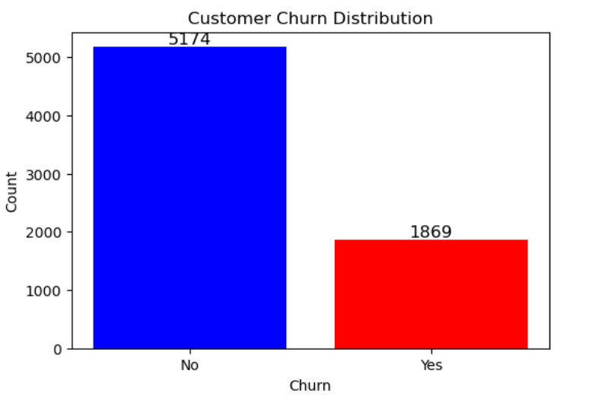

Project Overview
Objective:
Identify factors contributing to customer churn and propose solutions.
Dataset: 7043 customer records with 21 attributes.
Key Challenge: Imbalanced dataset with only 27% churned customers.

Slide 3
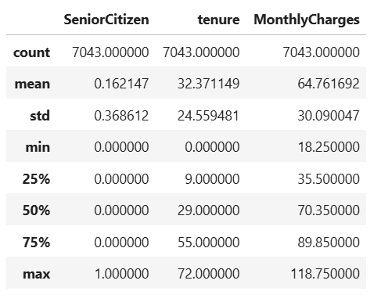
Data Summary
Exploratory Data Analysis
Total Customers: 7043
Churned Customers: 1869 (27%)
Features Include: Demographics, service usage, contract details, billing information.
Data Cleaning: Converted 'TotalCharges' to numeric, handled missing values.

Slide 4
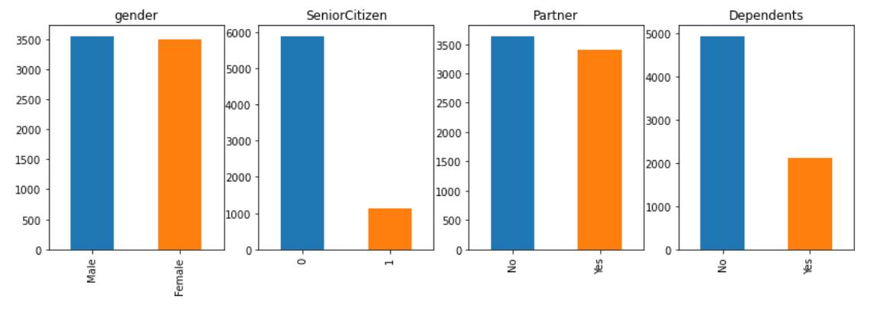
Visualizations & Findings
Demographics: There is an equal distribution of user gender and marital status. The most customers are younger individuals without dependents.

Slide 5
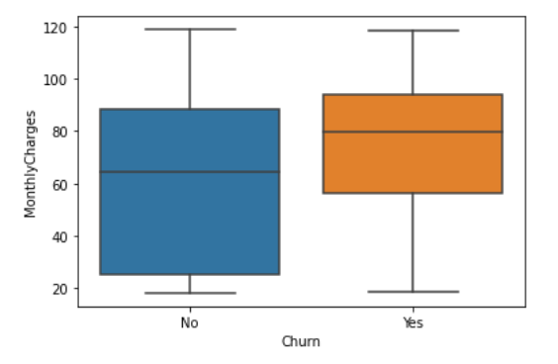
Visualizations & Findings
Monthly Charges: Higher charges correlate with higher churn.

Slide 6
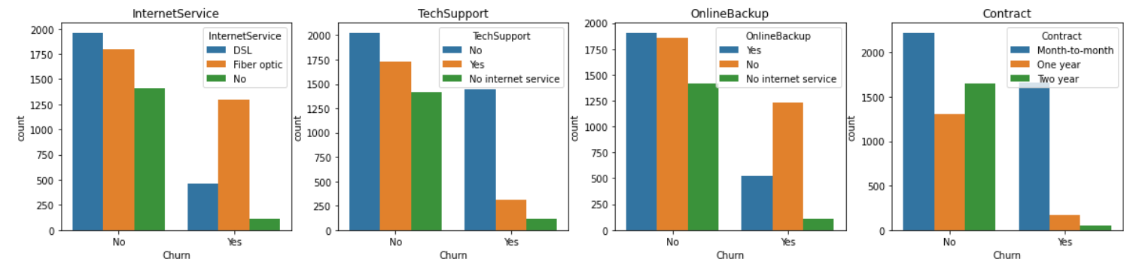
Visualizations & Findings
Contract Type: Month-to-month contracts see the highest churn.
Internet Service: Fiber optic users churn more frequently than DSL users.
Tech Support & Online Backup: Lack of support services increases churn risk.

Slide 7
Key Insights from Exploratory Data Analysis
· Internet Service:
Fiber optic users churn more frequently.
Possible reasons: higher costs or poor coverage.
Tech Support:
Many churned users did not subscribe to tech support.
Lack of technical assistance may have led to service cancellations.
Online Backup:
Many churned customers did not use online backup services.
Contract Type:
Churn is highest among customers with monthly contracts.
Monthly subscribers can easily cancel before the next billing cycle.
Actionable Insights:
Offering complimentary tech support may reduce churn.
Understanding churn drivers helps prevent customer loss.

Slide 8
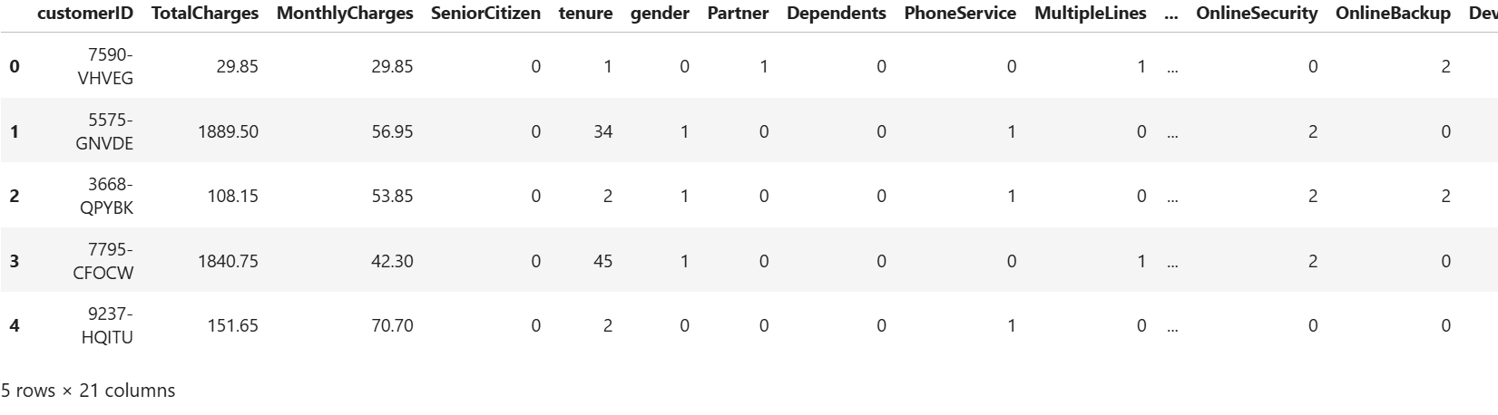
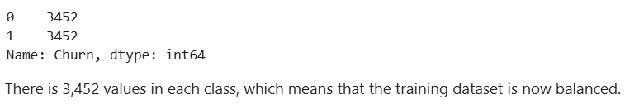
Data Preparation & Feature Engineering
Categorical Encoding: Transformed categorical variables into numerical values.
Feature Selection: Identified key predictors of churn.
Oversampling: Used SMOTE to balance dataset.

Slide 9
Predictive Modeling Strategy
Model Considered: Building the Customer Churn Prediction Model. We now built a random forest classifier to predict customer churn. Therefore, RandomForestClassifier(random_state=46)
Evaluation Metrics: Considering the Customer Churn Prediction Model Evaluation. We evaluated the model predictions on the test dataset with an Accuracy score of 0.77.
Preliminary Findings: Contract type and monthly charges are strong churn predictors.

Slide 10
Business Recommendations
Reduce Monthly Churn: Offer discounts or loyalty incentives for high-paying customers.
Improve Retention: Encourage annual contracts instead of month-to-month.
Enhance Support: Offer free tech support for new customers.
Customer Engagement: Target at-risk customers with personalized offers.

Slide 11
Next Steps - Iteration
Model Optimization: Fine-tune hyperparameters for better prediction.
Deployment: Implement real-time churn prediction model.
Continuous Monitoring: Track customer behavior and refine strategies

Slide 12
Telecom Customer Churn Analysis
Thank you!
Questions & Discussion
Contact: enyaudesamuel@gmail.com

